Slide 1
Youth Justice Tailored Dispositional Orders
Jenna Dunlap & Sarina Brummund, DCF Bureau of Youth Services
Christina Tenuta & Bridget Mauerman, Children’s Court Improvement Program

Slide 2
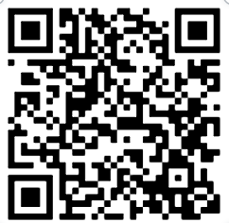
PowerPoint can be found in your folder.
Additional resource materials can be accessed at the following website under Training Materials:
www.wicciptraining.com/resources/

Slide 3
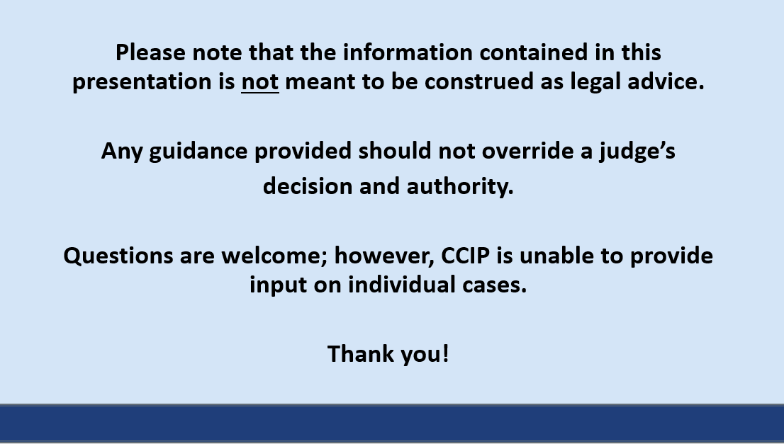
Notes:
Disclaimer

Slide 4
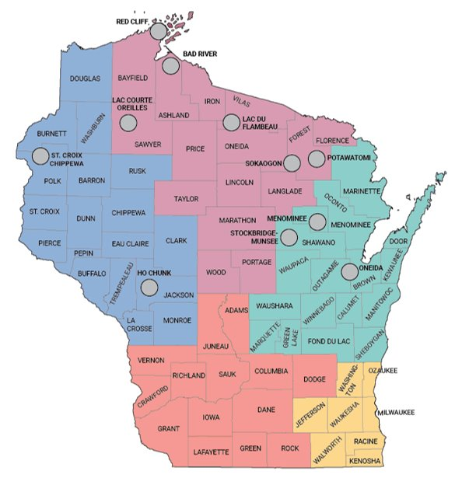
DCF is not permitted to provide guidance or specific consultations during this training.
Please contact your BRO regional coordinator for questions regarding active and open Youth Justice Cases.
BRO Regional Coordinator​
Northern – Christine Hegewald​
Northeastern – Kimberly Van Hoof​
Southeastern – Lonna Morouney​
Southern – Jessica George-Reyes​
Western – Lee Ann Davison

Slide 5
Learning Objectives
History of the TDO project
Youth Justice Strategic Plan
Research Highlights and YJ Data
YASI 101
YJ Court Report
Writing YJ TDO Conditions
YJ Case Planning with TDO
Research Cited
Continuing Education Credits
Judicial Officers
A Certificate of Attendance will be distributed to judges and court commissioners
Social Workers
Individuals responsible for entering training in PDS Online (see instructions)
Attorneys
CCIP will apply for CLE credits

Slide 6
YJ Pilot
DCF started a Judicial Workgroup in 2017 that focused on Tailored and Effective Youth Justice Court Orders.
Piloted in Monroe and Rock counties.
CHIPS Pilot
The Program Improvement Plan (PIP) involved the Tailored Dispositional Orders Project for CHIPS conditions.
Piloted in 3 counties - Barron, Manitowoc, and Waukesha
Current Project
DCF and CCIP jointly are expanding the Tailored Dispositional Orders Project statewide and allowing counties to choose to work on CHIPS and/or Youth Justice conditions
Notes:
CCIP – speak to the history. DCF Judicial workgroup was a catalyst for starting this work in WI.

Slide 7
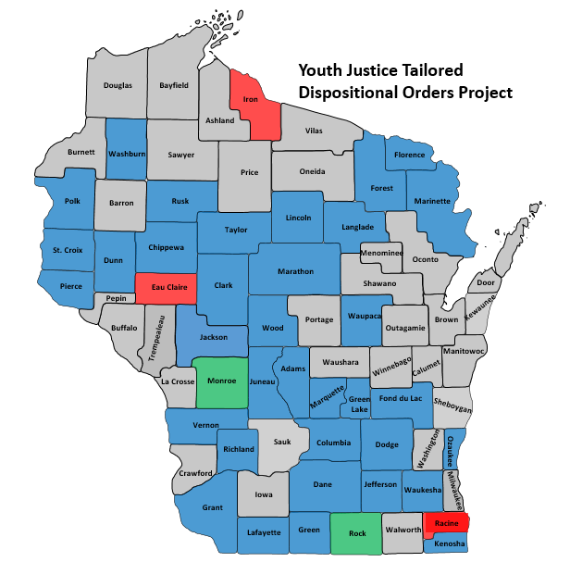
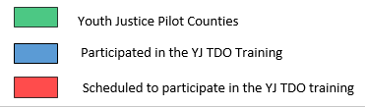
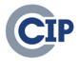

Last Update: 2/3/2026

Slide 8
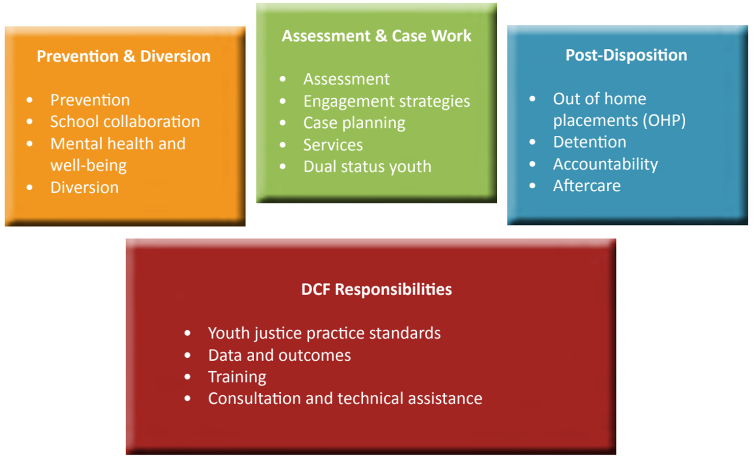
DCF Youth Justice Strategic Plan
Notes:
Jenna/Sarina ( Initial requests from counties through the county input gathering sessions).

Slide 9
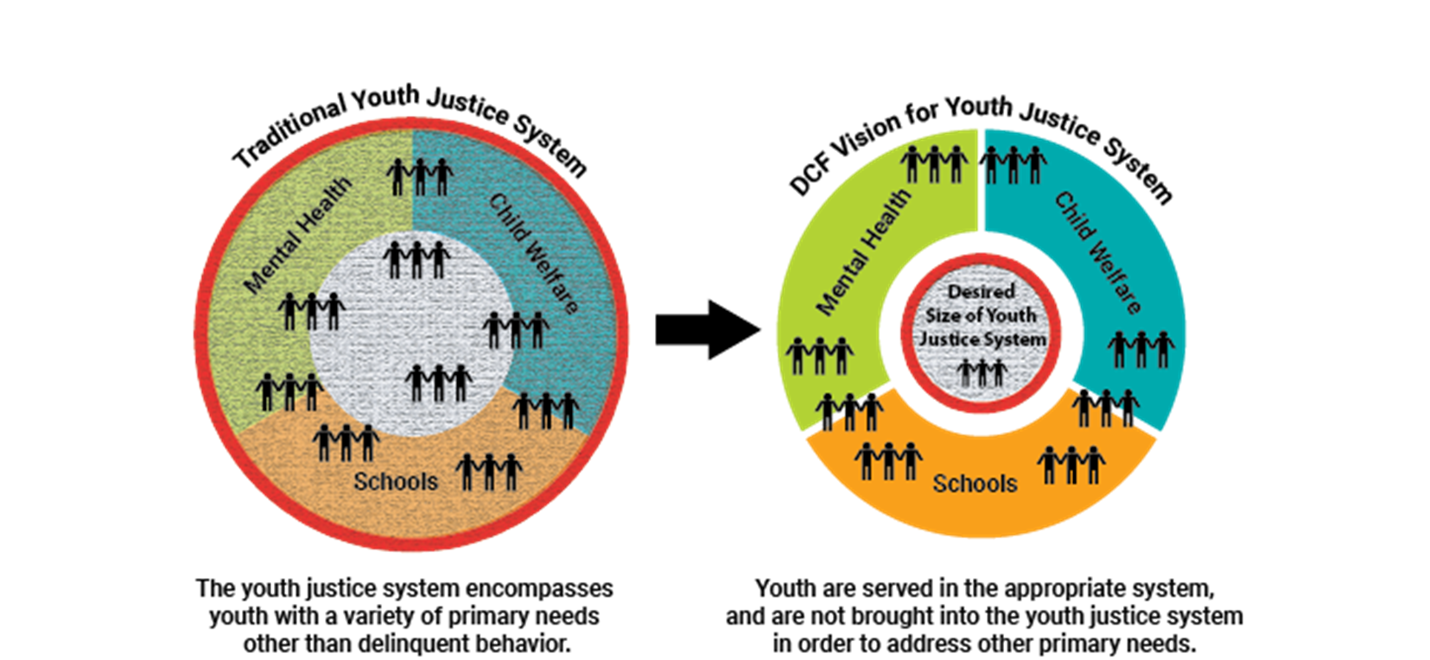
From Research to Practice
Notes:
Overarching goal to only bring in the youth that have primary needs related to delinquency, and not primary needs in MH, School-based issues.
The graph on the left represents what our YJ system has encompassed historically, youth with a variety of primary needs other than delinquency behavior.
The graph on the right represents what the state would like to see occur with our YJ system, we would like to see that youth are served in the most appropriate system and youth are not brought in the YJ system that could be met in more appropriate systems, child welfare, mental health and schools.
This does not reflect the youth that sometimes have complex needs and have significant need in multiple areas, these youth often require additional assessments.
CCIP – chimes in here acknowledging the challenges associated with Mental Health and resources available to counties.

Slide 10

Community-Based Youth Justice System
Prevention Services
Diversion Services
County Administered Post-Dispositional Services
Juvenile Correctional Facilities
(DOC Supervised)
Notes:
In addition to ensuring youth are served by the system or systems that best address their primary needs, we also want to be sure that the community-based youth justice system is designed to provide youth with the most appropriate level of intervention.
In this image, the labels highlighted in gold are portions of the system that are DCF supervised. We’d like YJ case managers in county human services to focus on the provision of diversion services and formal supervision to youth who need it the most.

Slide 11
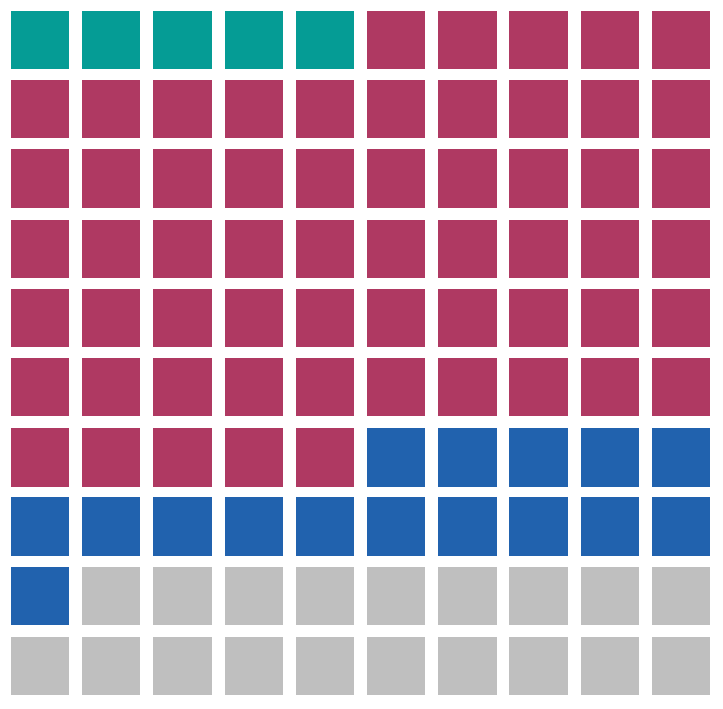
2024 Referred Youth with Prior CPS Referral(s) -Wisconsin
Prior CPS Referral(s)
■ Screened In Only (6%)
■ Screened In & Screened Out (60%)
■ Screened Out Only (16%)
■ No Prior Referral (18%)
82%
Notes:
More information about CPS screening decisions can be found in this case flow explanation of the Access process and in the annual Child Abuse and Neglect Report.

Slide 12
2024 YJ Referred Youth Out of Home Care (OHC) Placement Experience - Wisconsin
Youth with OHC experience prior to first 2024
YJ Referral
20 %
Youth Placed in OHC at the their first 2024 YJ Referral
5%
Wisconsin General Youth Population Placed in OHC in 2024
<1%
Notes:
More information about OHC placements can be found in the OHC dashboard and in the annual Out of Home Care Report.

Slide 13
Evidence-Based Practice Research Suggests
Severity of offense is not a strong indicator of the future pattern of offending; tested static and dynamic risk factors for offending are.
(Mulvey et al., 2010; Lipsey & Derzon, 1998).
Legal History
Family
School
Community Peer
Alcohol and Drugs
Employment/Free Time
Skills
Attitudes
Aggression/Violence
Notes:
Research on risk assessment tools and youth justice case processing – Research suggests that tested static and dynamic risk factors are strong indicators of future pattern of offending. Verbally deliver some examples and definitions but also put in notes.

Slide 14
EBP Research Suggests
Research shows us that when predicting outcomes for individuals in the justice system, justice professionals “get it right” [predicted risk/need accurately] about 50% of the time when using only their professional judgement. By using actuarial tools, or assessment tools like the YASI, we increase that accuracy to about 70-75%.
(Bonta & Andrews, 2017; Oleson et al., 2012; Grove et al., 2000; Gendreau et al., 1996; Grove & Meehl, 1996; Andrews et al., 1990.)
Notes:
Note – Verbally elaborate quickly on what does “Get it right mean” …. Put notes in here too.

Slide 15
What did WI do in response to their research on Youth Justice Practices?
Notes:
We researched many risk assessments tools and eventually selected YASI as the best tool for WI. The tool was also accompanied by a case planning model.

Slide 16


WI Youth Justice Standards
Youth Justice Standards
January 2023
Case Process & Documentation Standards
October 2023
YASI Standards
https://dcf.wisconsin.gov/files/cwportal/policy/pdf/yj-standards.pdf

Slide 17

The Youth Assessment & Screening Instrument (YASI)
Focuses on the Principles of Risk, Need, Responsivity (RNR)
Adapted from the Washington juvenile assessment model
Assesses risk level for re-offense
Identifies dynamic need factors
Documents a variety of responsivity factors (trauma, mental health concerns, motivations) to guide individualized intervention approaches
Uses Motivational Interviewing (MI) to inform both the assessment process and case planning
Incorporates validated strength scores in case planning
Notes:
RNR:
Risk principle: Match the level of service to the individual’s risk to re-offend.
Need principle: Assess criminogenic needs and target them in treatment.
Responsivity principle: Maximize the individual’s ability to learn from a rehabilitative intervention by providing cognitive behavioral treatment and tailoring the intervention to the learning style, motivation, abilities and strengths of the individual.
Assesses Youth Strengths and Protective Factors: Research on strengths and developmental assets has taught us how protective factors can buffer risk and promote resiliency. Youth at high-risk to reoffend who possess protective factors have appreciably better outcomes.
YASI is Gender Specific, Trauma Informed, Youth Focused and documents responsivity factors such as mental health and trauma.
MI: YASI uses an interviewing technique that is an evidence-based approach to behavior change.

Slide 18



Effective, Individualized Case Management Requires RNR Principles
Risk
Match the intensity of the intervention with one’s level of risk for re-offending
Need
Target dynamic or changeable risk factors (aka criminogenic needs)
Responsivity
Match the mode & strategies of services with the individual
Notes:
Ask for a show of hands, how many have heard this term?
Remind them that this is applies in adult and juvenile cases. This is the most robust research in the field of criminal justice in terms of what works.

Slide 19


YASI is not a ‘one size fits all’ tool
The YASI is not validated to assess risk/needs for the following:
Sexual Offenses
Most score low risk
Strongly recommend a psychosexual evaluation with a licensed professional.
Mental Health
Includes an Adverse Childhood Experiences (ACE) Score
NOT a proxy for mental health diagnosis
Pre-delinquency (Under age 10)
Truancy
Truancy is a status offense and is not a strong predictor of future delinquency, it is recommended counties use a validated needs assessment tool for truancy referrals.
Notes:
Widely-used SO Risk Assessment:
The Juvenile Sex Offender Assessment Protocol-II (J-SOAP-II)
https://www.ojp.gov/pdffiles1/ojjdp/202316.pdf

Slide 20
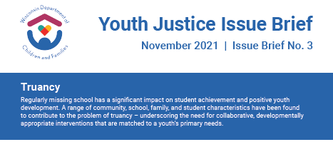
Truancy Research
“…the most effective approaches to truancy include families, schools, and communities, working together to set and consistently enforce rules for attendance.”
(Eastman, et.all., 2007; USDE, et.all., 2021.)
“Several examinations of truancy interventions have found harsh sanctions – like out-of-home placement, denial of family welfare benefits, or sending police to the homes of students – are more likely to increase the incidence of truancy” (Eastman, et.all., 2007; National Research Council. 2013.; Weber, Josh. 2020.)
Notes:
Limitations are normal. There is no ‘one size fits all’ assessment.
Use Diana’s hospital example. Choose the assessment based on the presenting symptoms.
Eastman, Gay, Siobhan M. Cooney, Cailin O’Connor, and Stephen A. Small. 2007. “Finding Effective Solutions to Truancy.” What Works, Wisconsin Research to Practice Series (5). UW-Extension. Retrieved August 2021 (https://fyi.extension.wisc.edu/whatworkswisconsin/files/2014/04/whatworks_05.pdf).

Slide 21
Validated Truancy Assessment Examples
School Refusal Assessment Scale Revised (SRAS-R)
Designed to evaluate “symptoms” of school refusal and identify the functional conditions contributing to a youth’s nonattendance. The 24 question surveys should be completed by both parent and child and are freely available online.
JIFF Interviewer
Self-administered, strengths-based tool that screens a youth and their caregiver
across 10 different life domains.
Following the short screener, a case plan
outline is software generated.
Notes:
List of effective truancy interventions can be found in our Truancy Issue Brief on our YJ Webpages. You will also find truancy data and county truancy programs highlighted.

Slide 22
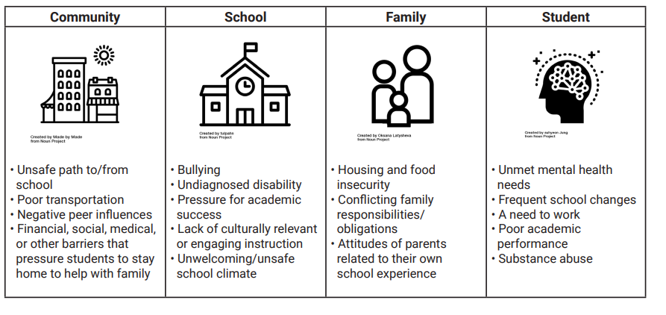
Truancy – Common Factors
A range of community, school, family and student factors and characteristics have been identified to contribute to truancy.
(Balfanz, Robert and Vaughn Byrnes. 2012)
Notes:
“A range of community, school, family and student factors and characteristics have been identified to contribute to truancy.”
Choose the assessment based on the presenting symptoms.

Slide 23


What Risk Assessments CAN do
What Risk Assessments
DO NOT do
Estimate the likelihood that delinquency behavior will continue without intervention
Guide case planning by identifying and indicating areas that are best targets for intervention
Standardize data collection
Identify frequent areas of need in a system/agency
Measure overall progress of youth on supervision
Provide common language between agencies
Reduce costs through “right sizing” use of intensive supervision, incarceration, and provision of services
Act as a “One Size Fits All” Tool
Assessments are validated to address specific issues
YASI not appropriate for sexual offenses, truancy, mental health diagnoses
Prescribe Outcomes– results are intended to guide decision making, not dictate a specific course of action or legal decisions
Replace Mental Health Assessments or Psychological Evaluations
Enable youth to avoid accountability
Adapted from Vincent, Guy, & Grisso, 2012
Notes:
Sarina/Jenna: Estimate the likelihood that delinquency behavior will continue without intervention (This is why low-risk youth should be diverted)

Slide 24
YASI DOMAINS
Legal History
Family
School
Community Peer
Alcohol and Drugs
Employment/Free Time
Skills
Attitudes
Aggression/Violence
Mental Health
Notes:
Pre-screen rapidly identifies ‘moderate’ and ‘high’ risk cases that will require more intensive services.
Strength scores: Added advantage of the YASI pre-screen is that it includes a validated strength measure. It derives a strength level of low, moderate or high as a standard component of the results. One of the most attractive features of the YASI is the incorporation of protective factors - or strengths. These are characteristics or resources that are likely to help reduce or “cushion” the negative impact of the identified risk factors.
Risk factors (Dynamic Need areas): Also produces a list of key need areas that represent elevated risk.
YASI Wheel: Full Assessment Screen once completed produces a wheel that maps for the risk and need areas for the YJ worker. This wheel is used by the staff member to develop recommendations and service match with the youth.
The scores on the top show the overall risk, static and dynamic risk, as well as our overall protective as well as static and dynamic protective factors.
Read the wheel as such:
Outside (red pieces) is risk level for each criminogenic need area
Inside (green pieces) is protective factor level for each pertinent area
Flags in Mental Health and Aggression is 0, 1, or 2 dependent on the amount of attention needed in these areas
When a reassessment or closure assessment is completed, there are also arrows that appear next to each risk and protective area to show an increase or decrease in each area (which is handy).
This is the 1 page visual we utilize with our clients to show them what was identified in the assessment results and to assist in having a conversation about where to begin to focus our case plan.

Slide 25
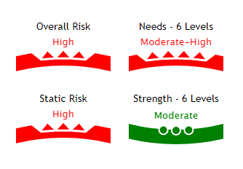
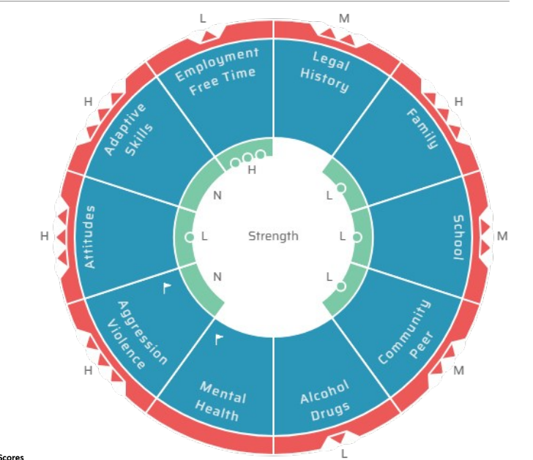
YASI Prescreen and Full Assessment
YJ professionals complete 30 hours of initial training.
All YJPs required to complete annual Booster training.
YASI Coaches complete an additional 33 hours of training, totaling 63 hours.
Very Low
Low
Moderate
Moderate High
High
Very High
Notes:
Pre-screen rapidly identifies ‘moderate’ and ‘high’ risk cases that will require more intensive services.
Strength scores: Added advantage of the YASI pre-screen is that it includes a validated strength measure. It derives a strength level of low, moderate or high as a standard component of the results. One of the most attractive features of the YASI is the incorporation of protective factors - or strengths. These are characteristics or resources that are likely to help reduce or “cushion” the negative impact of the identified risk factors.
Risk factors (Dynamic Need areas): Also produces a list of key need areas that represent elevated risk.
YASI Wheel: Full Assessment Screen once completed produces a wheel that maps for the risk and need areas for the YJ worker. This wheel is used by the staff member to develop recommendations and service match with the youth.
The scores on the top show the overall risk, static and dynamic risk, as well as our overall protective as well as static and dynamic protective factors.
Read the wheel as such:
Outside (red pieces) is risk level for each criminogenic need area
Inside (green pieces) is protective factor level for each pertinent area
Flags in Mental Health and Aggression is 0, 1, or 2 dependent on the amount of attention needed in these areas
When a reassessment or closure assessment is completed, there are also arrows that appear next to each risk and protective area to show an increase or decrease in each area (which is handy).
This is the 1 page visual we utilize with our clients to show them what was identified in the assessment results and to assist in having a conversation about where to begin to focus our case plan.

Slide 26







How and When Will the YASI be Used?
Intake Decision:
Risk (Who?)
Court Report:
Need (What?)
Case Plan:
Responsivity (How?)
YASI Prescreen
(33 Q’s)
YASI Full Assessment
(PS + 55 Q’s)
YASI Case Plan
(1-3 Domains)
YASI
Reassessments
High Risk:
Petition
Low Risk:
Divert
At least every
6 months

Slide 27
Wisconsin YASI Prescreen Overall Risk Levels:
CY 2025
7,037 Youth assessed with
YASI Pre-Screen
36%
Low Risk of re-referral
41%
Moderate Risk of re-referral
24%
High Risk of re-referral
Notes:
YASI Prescreens: 7,037 prescreens for 5,100 youth
Low Risk: 2,516 / 36%
Mod Risk: 2,861 / 41%
High Risk: 1,660 / 24%

Slide 28
Dynamic Protective Score and Dynamic Risk Score
What Can Court Partners Expect?
Dynamic Protective Score and
Dynamic Risk Score
“Improvable”
“Changeable”
Dynamic Risk - To provide effective services and reduce recidivism, it is important to focus on the “changeable” risk factors. The YASI focuses particular attention on dynamic elements. The Dynamic risk factors reflect the youth’s “needs” for service or attention in particular problem areas.
Dynamic Protective (Strengths) - Characteristics or resources that are likely to help reduce or “cushion” the negative impact of risk factors. The strengths assessment can help focus a case plan on maintaining or boosting protective factors where they already exist or help develop new resources for youth who lack strengths.

Slide 29

What can court partners expect to learn from the YASI?
Identified Areas of Strength with Description
Responsivity Factors

Slide 30
Dispositional Structure Matters
Bifurcated (adjudication & disposition separate) | Non-Bifurcated (adjudication & disposition together)
Time to complete YASI full assessment prior to adjudication Time to match service recommendations to identified youth needs prior to disposition Youth and family are aware of services that will likely be ordered – assists with engagement | Insufficient time to complete YASI full assessment prior to adjudication May have time if youth admits responsibility, but potential for due process violations Less time to match service recommendations to identified youth needs prior to disposition
Notes:
Bifurcated System:
100% bifurcated – 24 counties
Mostly bifurcated – 14 counties
Non-Bifurcated System:
100% non-bifurcated – 14 counties
Mostly non-bifurcated – 3
Also, may want to discuss a) 5 decades of research indicating best practice -- I have citations from the 50's and 60's available if desired -- and b) ***statutory obligation to bifurcate if any party prefers.***
CCIP - Importance of bifurcation and best practices. What are the barriers from court partners perspectives with non-bifurcated systems.

Slide 31
Example YJ Petition Flow
INTAKE AND COURT PROCESS
Referral to YJ
YJ Intake & YASI PS
Plea Hearing
YASI FA and Court Report/Recs
Disposition
Supervision
Adjudication
SUPERVISION
YASI
Case Plan
Focus on 1-3 targets
YASI
Reassessment
Progress?
At least every
6 months
YASI Case Closure Assessment
Notes:
Collaboration with youth in the development of the case plan is at the heart of CCW. YJ Staff learn concrete steps for case planning and ongoing supervision that is tied to the assessment tool.
Staff can also use a blank wheel to summarize what was learned from the assessment and develop a case plan on issues that are important to the youth, family and case worker.
Goals are always expressed in positive terms that point to desired outcomes that are valued by the youth.
Collaborative Case Work Process
Mapping: Assessment, interpretation of the results, feedback to youth
Planning: Mobilizing motivation, goal setting, selecting action steps
Reviewing and Supporting: Managing the plan as it progresses, reinforcing the positive gains

Slide 32
Youth Justice Disposition Report
Structure
Demographic Information
Youth legal/social history
Relevant CPS or YJ involvement & Placement history
Space and guidance for long-form narrative
YASI Information
Recommendations
Counties and Court Officials Involved in 2024 Template Design
Notes:
Structure
Basic information
Identifiers and demographics for youth, family, and current caregivers/placement as applicable
Youth legal/social history
User-selectable YJ, CPS, & Placement history
Space and guidance for long-form narrative
YASI Information (see slide)
Recommendations (see slide)

Slide 33
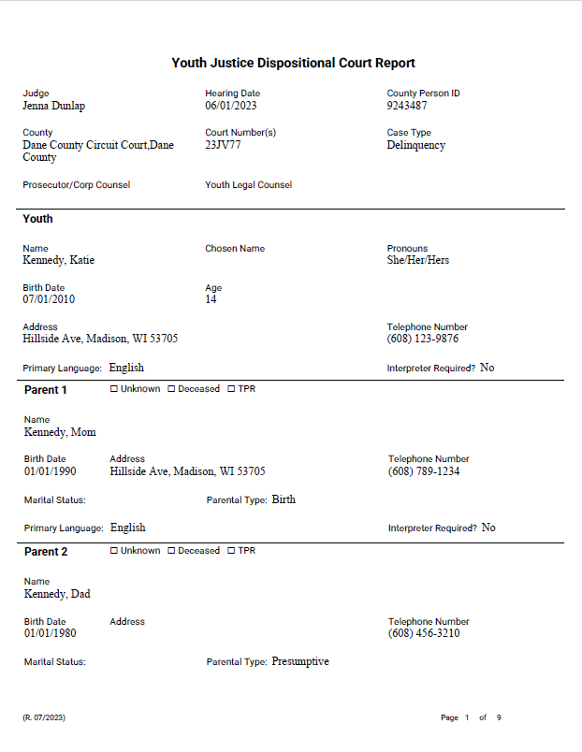
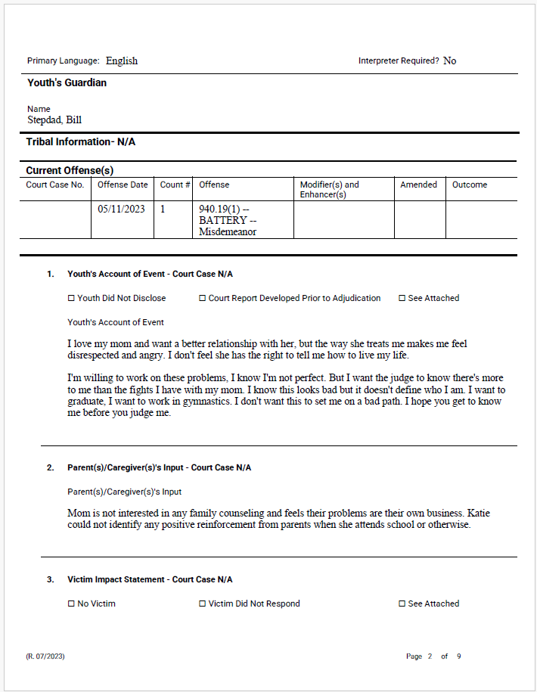
Notes:
Demographics.
Youth’s account of events
Parent’s input
Victim impact statement

Slide 34
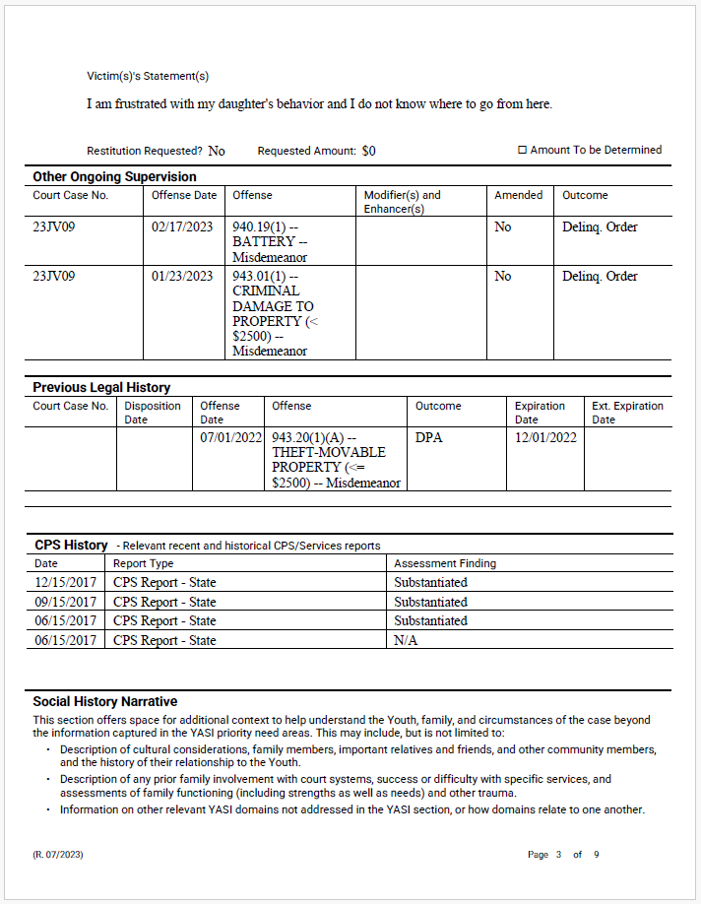
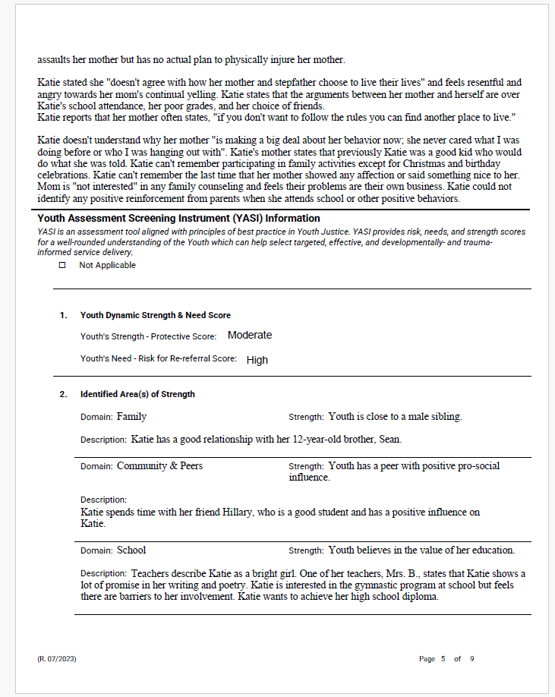
Notes:
Offense history and other ongoing supervision
Legal history
CPS history (optional)
Social history
YASI Strengths and needs

Slide 35
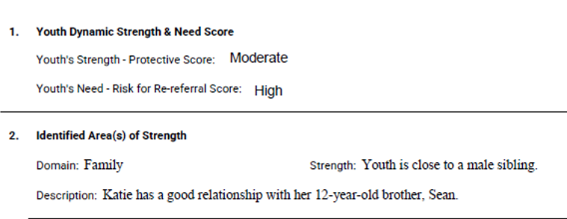
Notes:
Offense history and other ongoing supervision
Legal history
CPS history (optional)
Social history
YASI Strengths and needs

Slide 36
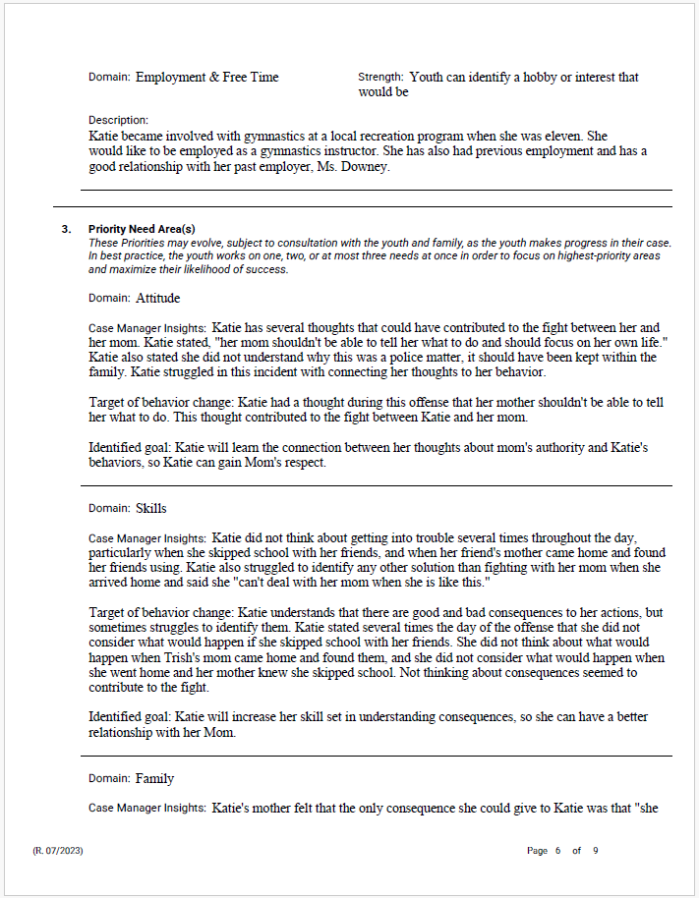
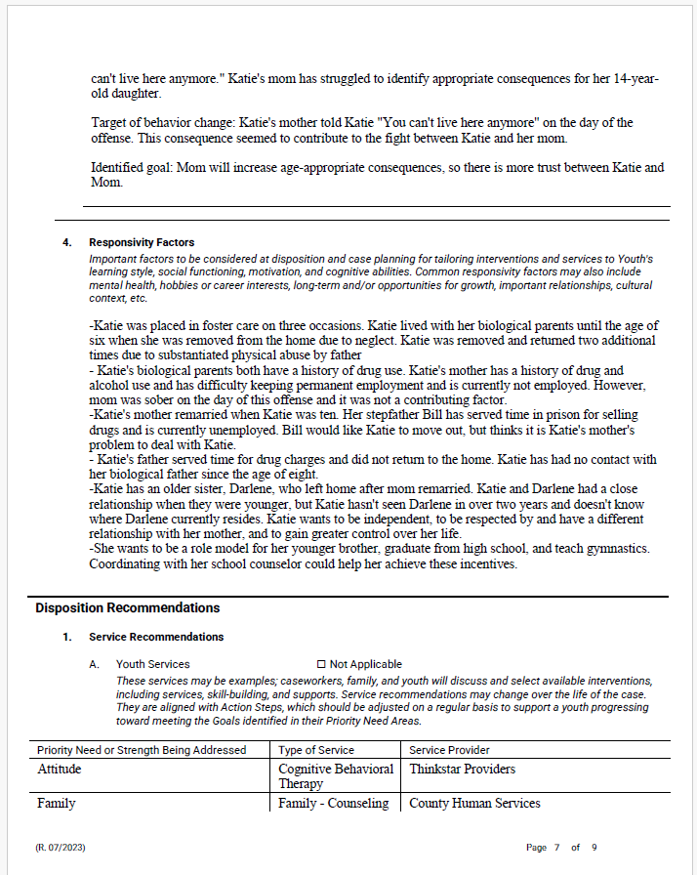
Notes:
Priority need areas
Responsivity factors
Dispo recommendations
Identification of possible Services

Slide 37
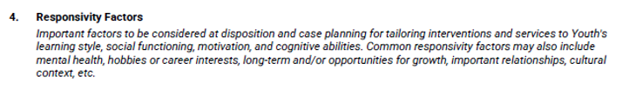
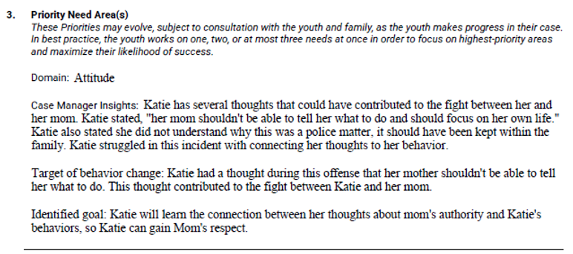
Notes:
Priority need areas
Responsivity factors
Dispo recommendations
Identification of possible Services

Slide 38
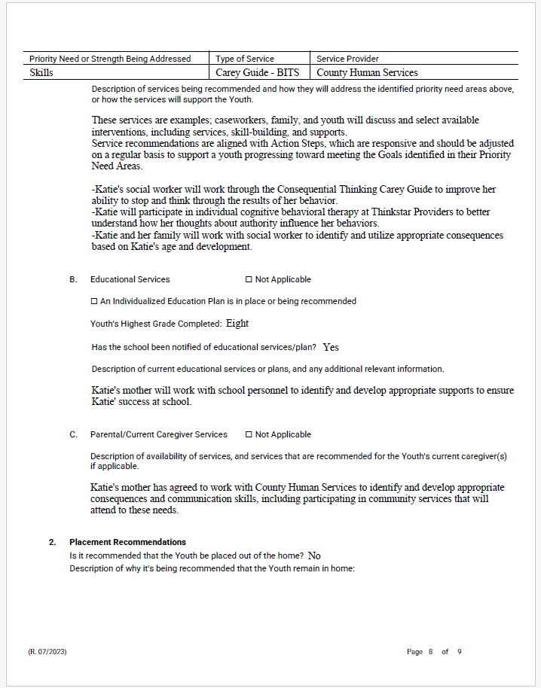
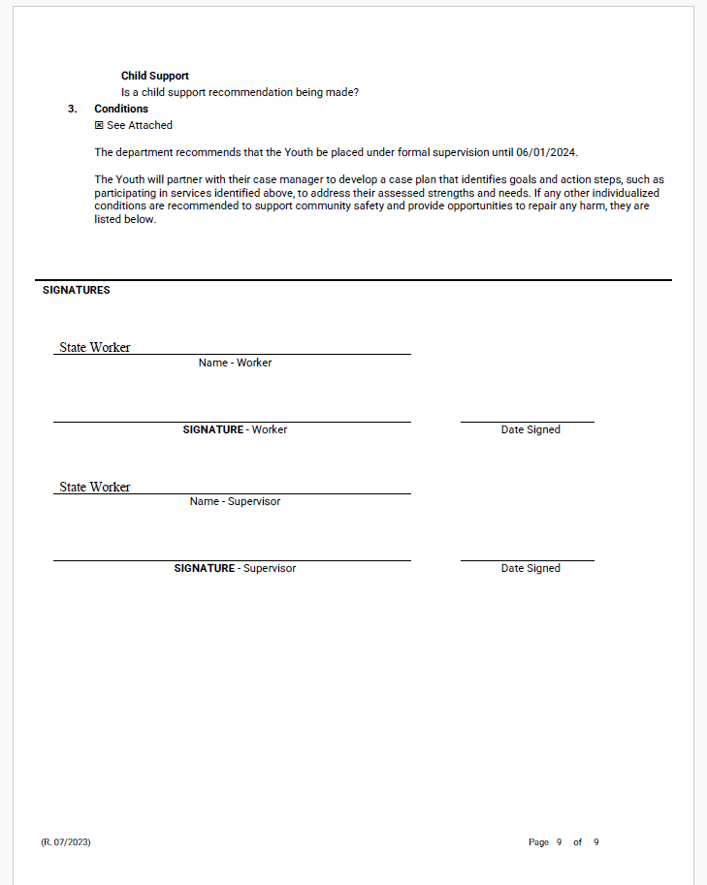
Notes:
Description of how the services may meet the needs and build strengths.
Statutory information for education
Parent obligations, services recommended
Placement/Child Support
Conditions.

Slide 39
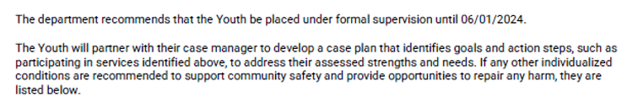
Notes:
Description of how the services may meet the needs and build strengths.
Statutory information for education
Parent obligations, services recommended
Placement/Child Support
Conditions.

Slide 40
YJ Court Report: Case Plan Condition
I will participate in developing a case plan that will help support my success on supervision. This case plan may require my participation in assessments, treatment, or programming. If any other individualized conditions are recommended to support community safety and provide opportunities to repair any harm, they are
listed below.

Slide 41
Accountability for Parents/Guardians
(1m) Orders imposing conditions on juvenile’s parent, guardian, or legal custodian.
(a) In a proceeding in which a juvenile has been adjudicated delinquent or has been found to be in need of protection or services under s. 938.13, the court may order the juvenile’s parent, guardian, or legal custodian to comply with any conditions determined by the court to be necessary for the juvenile’s welfare. An order may include participation in mental health treatment, anger management, individual or family counseling or parent training and education, and a requirement for a reasonable contribution, based on ability to pay, toward the cost of those services.
(b) A court may not order inpatient treatment under par. (a) for a juvenile’s parent, guardian or legal custodian. All inpatient treatment commitments or admissions must be conducted in accordance with ch. 51.
-- 938.45(1m)
Parents may have an attorney, call witnesses, or cross-examine witnesses on such an order.
Contempt warnings shall be given at the time of Disposition.
Prior to contempt filings, agency should make attempts to address resistance or lack of participation and share attempts with the court.

Slide 42
Approach & Accountability with Parents/Guardians
Accountability for Parents/Guardians
Example Condition:
“Caregiver’s Name” will help with case planning, developing goals and action steps. “Name” shall follow through with agreed upon plan for parenting, house rules and treatment for mental health or AODA concerns, which may include family therapy, individual therapy, parent coaching (etc.).
Example Condition:
“Caregiver’s Name” will list or find natural supports to help in achieving the parent’s goals, specific to improving outcomes for their child.
Notes:
Reading level is important, 4th grade is the average reading level. But let’s shoot for 8th grade reading level.

Slide 43
How do YASI and YJ Court Reports inform “Tailored Dispositional Orders”?
Notes:
Also

Slide 44
Tailoring YJ Conditions
The National Council of Juvenile and Family Court Judges (NCJFCJ) issued a 2017 resolution regarding tailoring Youth Justice conditions.
Too many juvenile courts and juvenile probation departments impose conditions of probation that are not individualized, have too many requirements, and lead to unnecessary detention or incarceration for technical violations.
Notes:
What is TDO
What are we here to discuss today.

Slide 45
YJ Dispositional Best Practices
Research
A more holistic understanding of youth paves the way for targeted, developmentally informed service delivery.
Dispositions based on risk level and needs are more likely to be effective. When services are matched to youth’s level of risk, strengths and criminogenic needs, chance of re-offense decreases (Peterson-Badali, Skilling, & Haqanee, 2014).
Overly broad and unclear orders that are not tailored to the strengths, interests, and challenges of an individual youth can result in significant numbers failing on probation, ultimately leading to costly and unnecessary out-of-home placement (NJDC, 2016).
Notes:
Well with all of this in mind… (next slide)

Slide 46
What is happening post-disposition?

Slide 47
A Few Notes about Case Plans
Case plans should be tailored to individual youth, rooted in RNR
YASI case plan does not include punitive services (electronic monitoring, fines, out of home placement)
Use of YASI does not preclude their use when necessary for public safety
YASI case plan is not the same as a court order
Service matrix classifies services already available in the community by domain and risk level
Creation of matrix can only highlight service gaps, will not fill them
Community’s ability to service match is only as good as the array of services available
Notes:
Case plans should not be one size fits all – each plan is tailored to the specific risk level, needs, and responsivity factors of individual youth.
A YASI case plan also will not include punitive services – HOWEVER, that does not mean those services cannot be used when necessary for public safety.
All counties were asked to create a service matrix early in YASI implementation to identify available interventions for each risk level within different domains.
No secret that in many communities, there are likely gaps in available services.
A community’s ability to match services to identified needs is only as good as the array of services available.

Slide 48
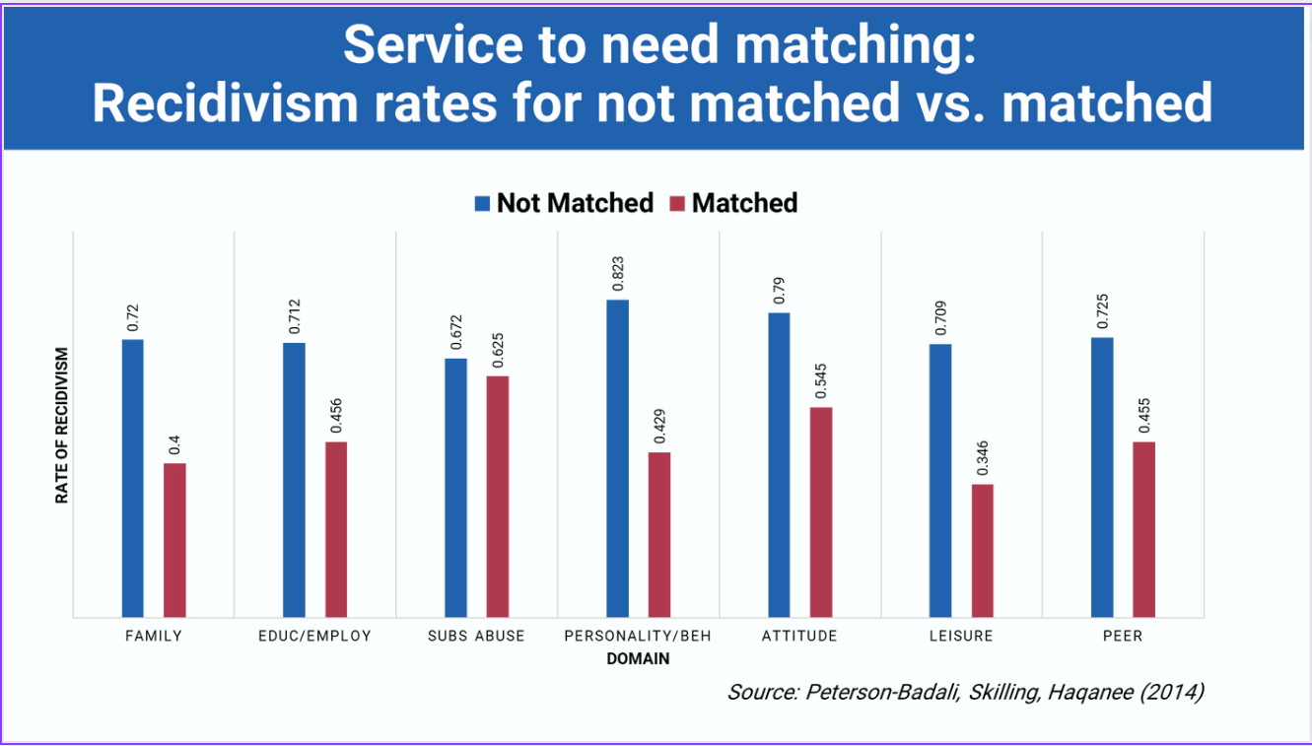
Notes:
Rate of recidivism decreases when we match services.
Research on implementation of a case management plan informed by valid risk assessment in justice services is important in contributing to evidence-based practice but has been neglected in youth justice. They examined the connections between risk assessment, treatment, and recidivism by focusing on the individual criminogenic needs domain level. Controlling for static risk, dynamic criminogenic needs significantly predicted re-offense. Meeting individual needs in treatment was associated with decreased offending. However, there is “slippage” in the system that reduces practitioners’ ability to effectively address needs. Even in domains where interventions are available, many youth are not receiving services matched to their needs. Implications and limitations of findings are discussed.
Peterson-Badali, M., Skilling, T., & Haqanee, Z. (2015). Examining implementation of risk assessment in case management for youth in the justice system. Criminal Justice and Behavior, 42(3), 304-320.

Slide 49

Matching Services to Needs Using a Service Matrix
Aggression/Violence Domain
EXAMPLE
Risk Level | General Recommendation | Services and Providers | Description of Services
Low | Family Group Counseling Promote family engagement | Completed by Human Service Agency
Moderate | MH Assessment Encouraged Other Txs: FFT, ART, CBT | Completed by Human Service Agency
High | Day Treatment Outpatient treatment or Groups RCC Treatment Program | Completed by Human Service Agency
County service matrices are not prescriptive. They are intended to serve as a guide for human service professionals in matching services to a youth’s individually identified need(s).
Notes:
Service Matrix, each county has one and would use it to case plan services/interventions with families post-dispo

Slide 50
Example Evidence-Based Case Plan
Priority Need Area | Target of behavior change | Identified goal | Action Step
Skills | Understands that there are good and bad consequences but sometimes fails to identify them. | Learn how to stop and think about the consequences of my behavior to avoid breaking rules. | Katie and her mom will meet next Tuesday to discuss 4 steps to improve communication with each other.
Attitudes | Expresses resentment toward authority (especially mother). | Learn the connection between my thoughts about mom’s authority and my violent behaviors. | Katie and her mom will meet on Tuesdays to identify 4 steps to communication and share their agreement with case manager.
Family | Parents use inappropriate consequences for negative behavior. | Develop appropriate consequences by parents. | Google appropriate consequences for 15 y/o by next Thursday and share with case manager during our meeting on Friday.
Notes:
Research shows us that when predicting outcomes for individuals in the justice system, justice professionals “get it right” about 50% of the time when using only their professional judgement. By using actuarial tools, or assessment tools like the YASI, we increase that accuracy to about 70-75%.
Administering an empirically based risk assessment tool and then using those findings to guide case planning, is an example of an Evidence-Based Practice.
Let’s look at the example case of Katie Kennedy. She gets into a physical fight with her mom after skipping school with her friends for the day and coming home late. The YASI identifies strengths, but also areas that are needs for the family, including Katie’s attendance at school, her peer group, and AODA concerns within the family. In the past, our professional judgement might lead us to believe that we should case plan around Katie’s truancy, her delinquent friends, or Mom’s struggles with drinking. These are aspects of the story that we can easily see and measure. However, when we use the YASI Assessment, we see that the issues that repeatedly arise between Katie and Mom are more likely due to Katie’s thoughts/feelings towards authority figures (Mom), her belief that the use of physical aggression is sometimes warranted, her inability to think about the consequences of her actions, and Mom’s lack of appropriate consequences when Katie breaks the rules.
If we use only professional judgement, we might increase Katie’s school attendance, something that was not the main focus of the current referral, but we would also likely see her back with a new referral for fighting with Mom (or another authority figure) under different circumstances. The YASI helps us to pinpoint the specific internals, that are often hard to see outwardly, by focusing on the event that led to the referral. There may also be specific external parts of a youth’s referral behavior, that when addressed, may lower the risk of recidivism. Youth Justice Professionals are trained to conduct behavioral analysis interviews with the youth, family, and other credible resources to get to these internals and externals with the youth, to develop an evidence-based case plan.

Slide 51
Sanctions for Court Order Violations
Secure Detention
Non-Secure Detention
Suspend Hunting/Fishing
Home Detention & EM
Community Service
Suspension of Driving Privileges
Notes:
Keeping in mind these are the sanctions available….
What can worker do in short of these violations: Worker may request meeting with family, YASI reassessment, or meeting with school (depending on case)_
1. Placement in a secure detention facility (delinquency only) for not more than 10 days per violation.
2. Placement in a shelter or other non-secure facility for up to 10 days per violation
3. Suspension of operating privilege or a hunting or fishing license for not more than 3 years.
4. Detention in my home or current residence for a period of not more than 30 days under rules of supervision specified in the order including Electronic Monitoring.
5. Not more than 25 hours without pay in a supervised work program or other community service.
6. A case manager may take me into custody and place me in a secure detention facility or in a shelter or other non-secure facility without a hearing for 72 hours if I violate the terms of supervision or if I am under investigation for violating the terms of supervision.
7. [Intensive Supervision only] A case manager may take me into custody and place me in non-secure custody for not more than 30 days if I am in need of crisis intervention.
What can worker do in short of these violations: Worker may request meeting with family, YASI reassessment, or meeting with school (depending on case)_
Ensure that when you are drafting conditions that the violation would warrant going back into court for any of the above sanctions. Its important to have a consistent message about violations across all conditions.

Slide 52
How will these changes lead to better outcomes for youth in Wisconsin?

Slide 53
Research on Tailored Conditions
When there are a large number of conditions, they become meaningless, unsuitable, overwhelming, and less likely to be enforced.
We are successful when…
Conditions are tailored to the youth’s identified needs and strengths, they are enforceable, and written in a way that is easily understood by youth.
Buy-in from youth/families; drafting conditions and case plan should be a collaborative process.
Stay focused on the essentials and priorities!
Notes:
RNR:
Risk principle: Match the level of service to the individual’s risk to re-offend.
Need principle: Assess criminogenic needs and target them in treatment.
Responsivity principle: Maximize the individual’s ability to learn from a rehabilitative intervention by providing cognitive behavioral treatment and tailoring the intervention to the learning style, motivation, abilities and strengths of the individual.
Assesses Youth Strengths and Protective Factors: Research on strengths and developmental assets has taught us how protective factors can buffer risk and promote resiliency. Youth at high-risk to reoffend who possess protective factors have appreciably better outcomes.
YASI is Gender Specific, Trauma Informed, Youth Focused and documents responsivity factors such as mental health and trauma.
MI: YASI uses an interviewing technique that is an evidence-based approach to behavior change.

Slide 54



Keys to Achieving Better Outcomes
Work effectively with court partners
Incorporate YASI results into decision-making
Educate yourself and others about RNR
Ensure services and programming are informed by the YASI
Matching services to youth’s priority needs is critical!
Divert Low-Risk
Avoid bringing low-risk youth into the formal ‘system’
Focus resources on youth with the greatest need

Slide 55
DCF is asking you to:
1
Collaborate with your human service agency and other court stakeholders to discuss how the YASI will be incorporated into your practice
2
Evaluate your court processes and consider adopting/advocating for a more tailored and effective court order model
3
Engage with DCF about its plans for youth justice system improvements and become a YASI change champion
Notes:
Research on the use of validated assessments in youth justice has grown significantly in the last decade. Assessment tools are often described as the foundation of evidence-based practices.
• We do not want to intervene more or less than is necessary. A validated assessment tool helps us match youth with the most effective level and type of supervision and services.
• This is about a more efficient use of resources to improve outcomes for youth and families, and ultimately increase community safety.

Slide 56

DCF Provided Tools
Available to All Counties
Youth Assessment & Screening Instrument (YASI)
YJ Court Report
On Demand Data from eWiSACWIS
Additional Support
(must apply/request)
Tailored Dispositional Orders (TDO) Training
Youth Justice Innovation Grants
Community Intervention Program (CIP)
Notes:
DCF provides counties with several tools to accomplish this vision.
We’ll talk in more detail about the YASI and YJ court report in a moment.
Data is a really important component of any evidence-informed practice as it helps us to check on how we’re doing. Counties also have access to some YJ referral and YASI data via eWiSACWIS and DCF staff is always available to support in basic analysis of that information as needed.
There are also a few tools that are available upon request or via competitive opportunity.
This includes the Tailored Dispositional Orders Training and two grant opportunities – the YJ innovation grants and the community intervention program
YJ is still relatively new to DCF, so we are continuing to build out the state provided resources available to counties. We are hoping this list will grow with time!

Slide 57




Where to Find More Wisconsin YJ Data
YJ Annual Reports (https://dcf.wisconsin.gov/ys/yj)
Youth Justice Referrals and Intake Report
eWReports (Data from eWiSACWIS)*
YJ Referral and Intake
YASI Assessment
Child Welfare Reports and Dashboards
(https://dcf.wisconsin.gov/cwportal/reports)
OHC Dashboard
CPS Dashboard
Older Youth Outcomes Dashboard
Notes:
eWReports – external partners cannot run these reports, will need to partner with their county human service agencies to get it.
As the question: After seeing these data slides, ‘What do you want to see/know?’

Slide 58
Works Cited
Andrews, D. A., Zinger, I., Hoge, R. D., Bonta, J., Gendreau, P., & Cullen, F. T. (1990). Does correctional treatment work? A clinically relevant and psychologically informed meta-analysis *. Criminology, 28(3), 369–404. https://doi.org/10.1111/j.1745-9125.1990.tb01330.x
Bonta, J., Andrews, D. A., & Andrews, D. A. (2017). The psychology of criminal conduct (Sixth Edition). Routledge, Taylor & Francis Group.
Gendreau, P., Little, T., & Goggin, C. (1996). A meta-analysis of the predictors of adult offender recidivism: What works! *. Criminology, 34(4), 575–608. https://doi.org/10.1111/j.1745-9125.1996.tb01220.x
Grove, W. M., & Meehl, P. E. (1996). Comparative efficiency of informal (Subjective, impressionistic) and formal (Mechanical, algorithmic) prediction procedures: The clinical–statistical controversy. Psychology, Public Policy, and Law, 2(2), 293–323. https://doi.org/10.1037/1076-8971.2.2.293
Grove, W. M., Zald, D. H., Lebow, B. S., Snitz, B. E., & Nelson, C. (2000). Clinical versus mechanical prediction: A meta-analysis. Psychological Assessment, 12(1), 19–30. https://doi.org/10.1037/1040-3590.12.1.19
Howell, J. C., Lipsey, M. W., & Wilson, J. J. (2014). A handbook for evidence-based juvenile justice systems. Lexington Books.
Lipsey, M. W., & Derzon, J. H. (1998). Predictors of violent or serious delinquency in adolescence and early adulthood: A synthesis of longitudinal research. In Serious & violent juvenile offenders: Risk factors and successful interventions (pp. 86–105). Sage Publications, Inc.
Mulvey, E. P., Steinberg, L., Piquero, A. R., Besana, M., Fagan, J., Schubert, C., & Cauffman, E. (2010). Trajectories of desistance and continuity in antisocial behavior following court adjudication among serious adolescent offenders. Development and Psychopathology, 22(2), 453–475. https://doi.org/10.1017/S0954579410000179
Oleson, J. C., VanBenschoten, S., Robinson, C., Lowenkamp, C. T., & Holsinger, A. M. (2012). Actuarial and clinical assessment of criminogenic needs: Identifying supervision priorities among federal probation officers. Journal of Crime and Justice, 35(2), 239–248. https://doi.org/10.1080/0735648X.2012.674819
Peterson-Badali, M., Skilling, T., & Haqanee, Z. (2015). Examining implementation of risk assessment in case management for youth in the justice system. Criminal Justice and Behavior, 42(3), 304–320. https://doi.org/10.1177/0093854814549595
Vincent, G. M., Guy, L. S., Perrault, R. T., & Gershenson, B. (2016). Risk assessment matters, but only when implemented well: A multisite study in juvenile probation. Law and Human Behavior, 40(6), 683–696. https://doi.org/10.1037/lhb0000214

Slide 59
Truancy References
DCF Truancy Issue Brief, November 2021 - https://dcf.wisconsin.gov/files/publications/pdf/5489.pdf
School Refusal Assessment Scale Revised (SRAS-R) - https://schoolavoidance.org/school-avoidance-101/
JIFF Interviewer - https://www.fasoutcomes.com/?ContentID=14
Balfanz, Robert and Vaughn Byrnes. 2012. Chronic Absenteeism: Summarizing What We Know from Nationally Available Data. Baltimore: Johns Hopkins University Center for Social Organization of Schools. Retrieved August 2021 (https://new.every1graduates.org/wp-content/uploads/2012/05/ FINALChronicAbsenteeismReport_May16.pdf).
Eastman, Gay, Siobhan M. Cooney, Cailin O’Connor, and Stephen A. Small. 2007. “Finding Effective Solutions to Truancy.” What Works, Wisconsin Research to Practice Series (5). UW-Extension. Retrieved August 2021 (https://fyi.extension.wisc.edu/whatworkswisconsin/files/2014/04/whatworks_05.pdf).
U.S. Departments of Education, Health and Human Services, Housing and Urban Development, and Justice. 2015. Every Student, Every Day: A Community Toolkit to Address and Eliminate Chronic Absenteeism. Retrieved August 2021 (https://www2.ed.gov/about/inits/ed/chronicabsenteeism/toolkit.pdf).

Slide 60
Sexual Offense Resources
Juvenile Sex Offender Assessment Protocol-II Manual - https://www.ojp.gov/pdffiles1/ojjdp/202316.pdf
Hecker, J., Scoular, J., Righthand, S., & Nangle, D. (2002, October). Predictive validity of the JSOAP over 10-plus years: Implications for risk assessment. Paper presented at the Annual Meeting of the Association for Treatment of Sexual Abusers, Montreal, Quebec, Canada.
Waite, D., Pinkerton, R., Wieckowski, E., McGarvey, E., & Brown, G. L. (2002, October). Tracking treatment outcome among juvenile sexual offenders: A nine year follow-up study. Paper presented at the Annual Meeting of the Association for Treatment of Sexual Abusers, Montreal, Quebec, Canada.

Slide 61
Contacts
Bridget Mauerman
Director
Children’s Court Improvement Program
Bridget.Mauerman@wicourts.gov
Christina Tenuta
Legal Advisor
Children’s Court Improvement Program
Christina.Tenuta@wicourts.gov
Jenna Dunlap
DCF YJ Policy Coordinator
Jenna.Dunlap1@wisconsin.gov
Sarina Brummund
DCF YJ Policy Coordinator
Sarina.Wiesner@wisconsin.gov
DCF Youth Justice Inbox
dcfyj@wisconsin.gov
Evelyn Coker
DCF Bureau of Youth Services Director
Evelyn.Coker@wisconsin.gov

Slide 62
Example of Conditions
I will obey all laws, statutes, and ordinances. I will notify my case manager of any police contact within 48 hours (for assistance and to troubleshoot).
I will participate in developing a case plan that will help support my success on supervision. This case plan may require my participation in assessments, treatment, or programming.
I will meet with a case manager at least once per month, or as directed in my case plan. I understand that this contact may occur at my home, school, or other settings.
If I meet my conditions successfully my case manager may make a request to end supervision. If I believe I have met my conditions successfully and would be appropriate for early termination, I may write to my judge 90 days before my supervision is set to expire to request supervision to end.
Special conditions specific to case and offense.
Notes:
Flexible in where counties may land on the spectrum. Depending on where their court partners are…
Discussion with YJ conditions. Where would you like to start?

Slide 63
Other Example Language for Specific Conditions
Youth will develop goals and actions steps to address their mental health needs, which may include a mental health evaluation and any recommended treatment.
Youth will complete an approved restorative justice program to address impacts to victim and the community.
Youth will complete a psychosexual evaluation with a licensed professional and follow treatment recommendations that address and reduce risk of sexual offending behavior.
I will work with my school/case manager to develop an educational plan that helps me meet my educational needs.
Notes:
Flexible in where counties may land on the spectrum. Depending on where their court partners are…
Discussion with YJ conditions. Where would you like to start?

Slide 64
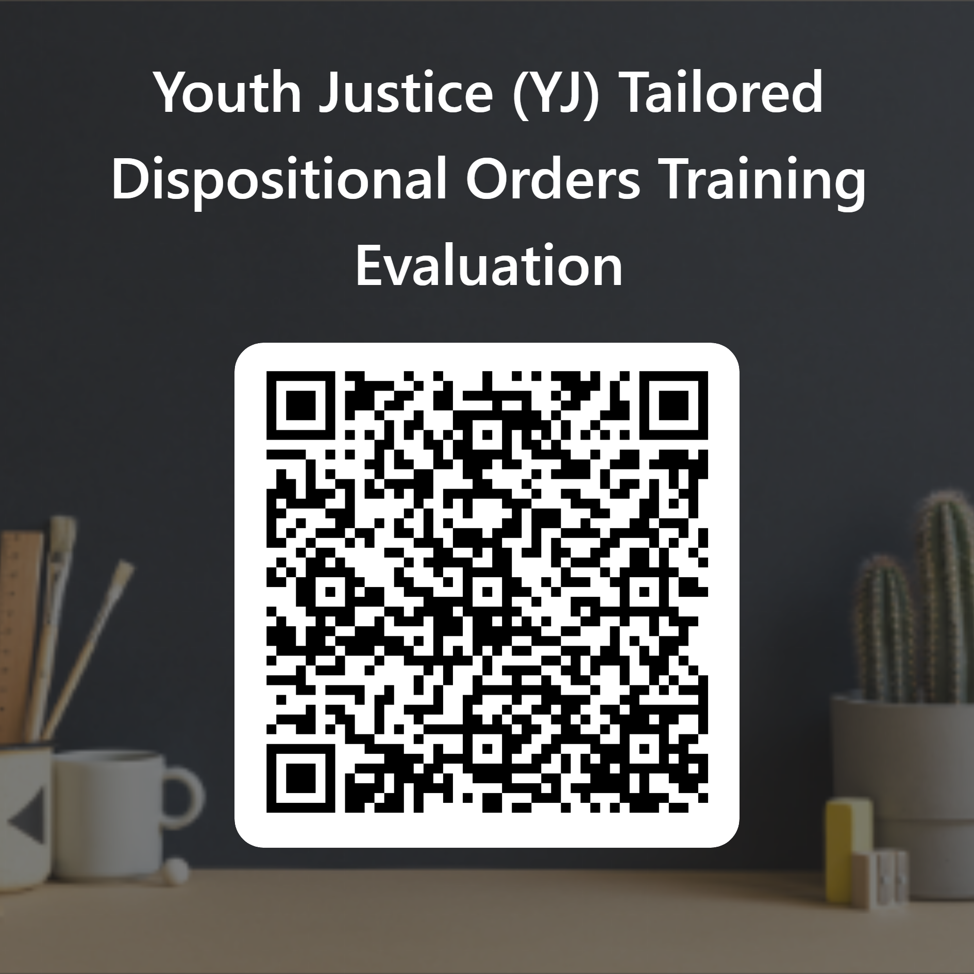

Use camera on a smart device to scan code and complete course evaluation

